Slide 1
Shell Bootcamp 2024 3 Reflections for Week #<>
Gnanateja Reddy
Date : 30-Aug-2024

Slide 2

About Me
Seek understanding ,act with integrity, and embrace growth

Slide 3

My learnings from this week!

Slide 4

Learning 1 | My takeaways
.
Always strive to express yourselves clearly
Since no one can read our minds , its essential to make our intentions explicit
In high-risk industries like SHELL’s effective planning , coordination, and communication with everyone are crucial for ensuring safety

Slide 5
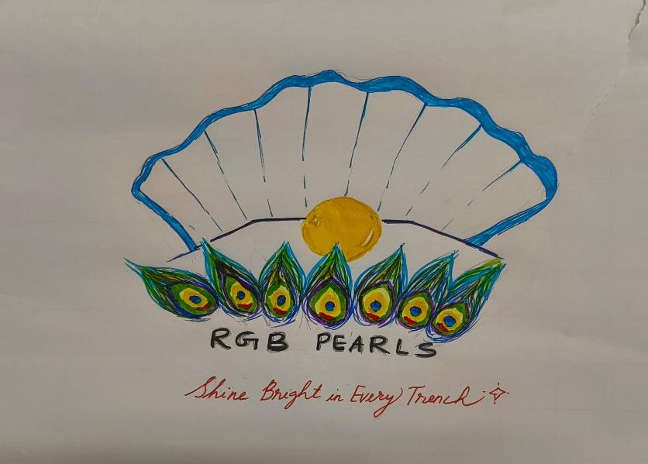
Learning 2 | My takeaways
Memory Improvement Techniques : Methods to enhance sequence recall.
Neuroplasticity Insights: Understanding how the brain adapts and reorganizes
Stakeholder Dynamics : Recognizing people involved and impact in various situations
Stakeholder Management :Identifying stakeholders ,planning their management, engaging with them.
Power Interest Grid overview : Learning about the grid used to assess stakeholder influence and interest
Presentation skills

Slide 6
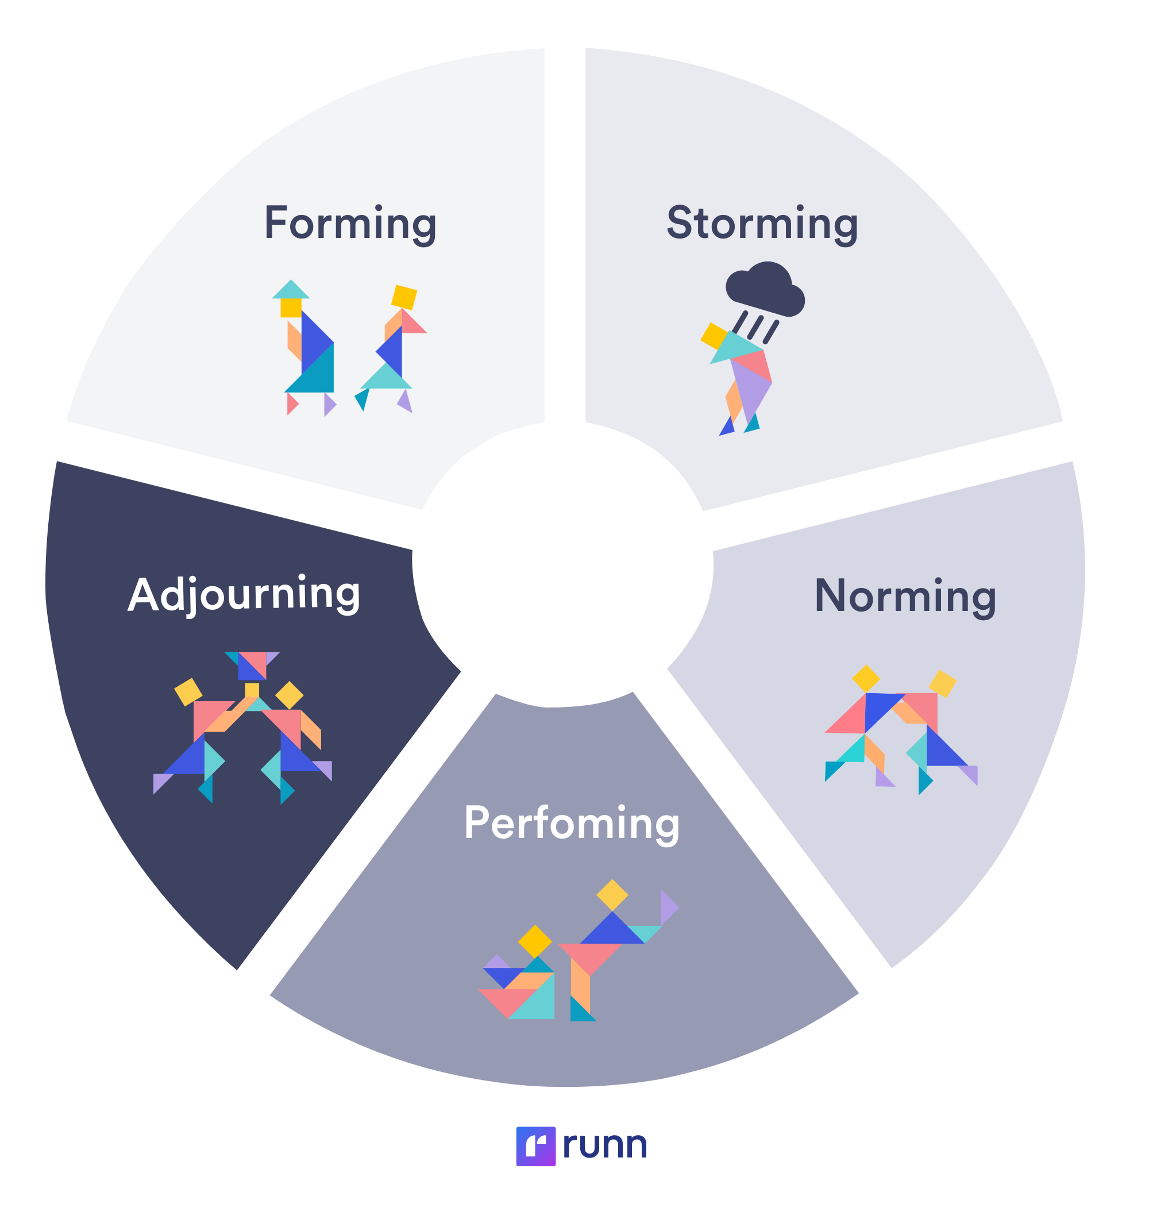
Learning 3 | My takeaways
Speech Structures : OBC(Opening, Body, Conclusion) and PREP(Point, Reason, Example, Point)
Understand the significance of the Power of Triad
Stages of team development – Forming, Norming, Storming and Performing.
Gave Presentation to identify strengths and weaknesses
Shell Trust Equation

Slide 7
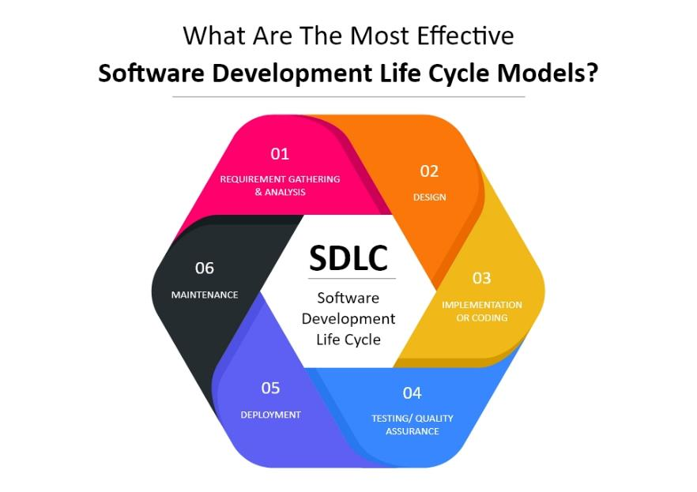
Learning 4 | My takeaways
SOS(Scrum of Scrums)
Business Analysis
Functional and Non-functional requirements
Requirement analysis and techniques for requirements gathering .
SDLC model and its 6 stages
Waterfall model and Agile model
Product Increment

Slide 8
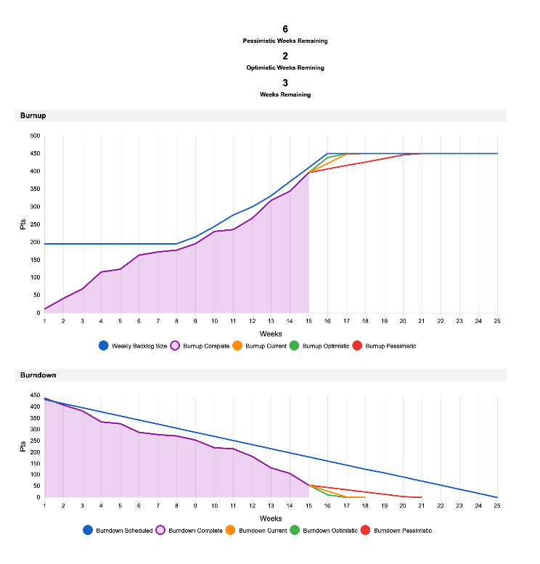
Learning 5 | My takeaways
Burndown vs Burnup charts
Scrum benefits
Product backlog
User story vs enabler story
Epics, User stories, Sprints
Retrospective
Monolithic architecture vs Microservice architecture
Definition of Ready vs definition of done

Slide 9

Relevance of learnings for my organization

Slide 10

Learning 1 | Relevance for Shell
How I feel Shell implements this learning :
Shell likely implements this learning by conducting regular safety briefings, ensuring clear communication of safety protocols, and fostering an environment where employees are encouraged to express their concerns and ideas openly. They might also use visual aids and planning documents to make their intentions explicit and ensure everyone is on the same page.
How I feel Shell benefits from this learning :
By implementing these practices, Shell benefits through enhanced safety standards, reduced risk of accidents, and improved overall efficiency. Clear communication and explicit intentions help in building trust among employees, leading to a more cohesive and productive work environment.

Slide 11

Learning 2 | Relevance for Shell
Shell employs effective communication and networking strategies, such as Get to Know You sessions (GTKYs). The bootcamp highlighted the importance of maintaining a positive attitude and fostering a supportive work environment. Shell practices an open culture where collegiality is evident, reflecting a constructive mindset among employees. Understanding stakeholder management has been instrumental in recognizing both the internal and external stakeholders involved with Shell.

Slide 12
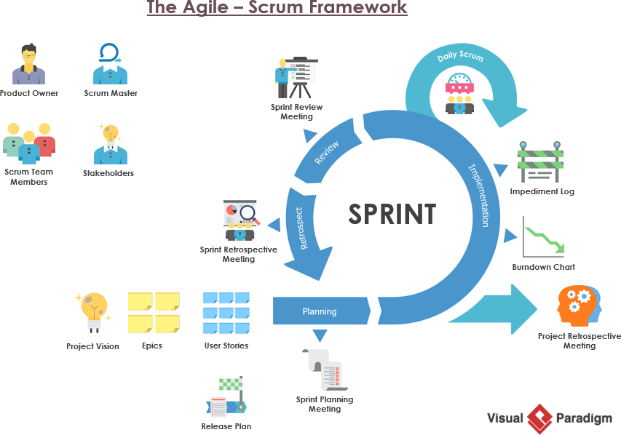
Learning 3 | Relevance for Shell
Business Analysis aids in making informed decisions, leading to increased revenue. It involves iterative activities that ensure the proper elicitation, documentation, refinement, and management of requirements throughout a project lifecycle. Agile methodology offers several benefits, including cost reduction, quality improvement, decreased timeframes, risk mitigation, increased flexibility, and continuous improvement. Shell employs a Scrum-based Agile method, which enhances work efficiency.

Slide 13

Challenges in implementing learning

Slide 14
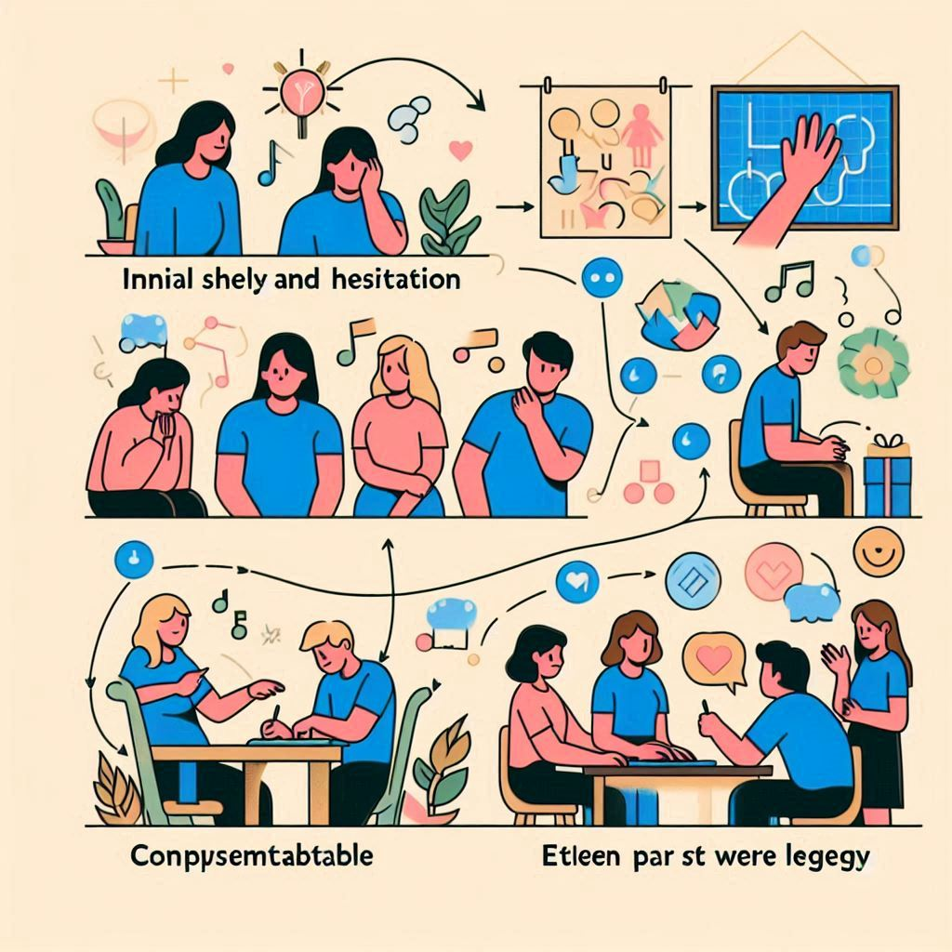
Challenge faced while implementing Learning 1
Initially, everyone was new and shy, making them hesitant to share. However, the activities helped people bond and connect with each other. Although some parts were a bit lengthy, they were presented in a fun and comprehensible manner.

Slide 15
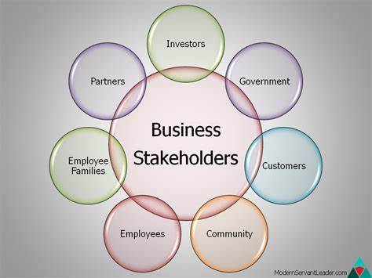
Challenge faced while implementing Learning 2
Initially, understanding Stakeholder Management was challenging due to its complexity.
It involves identifying, analyzing, and managing the expectations of various stakeholders.
Balancing differing priorities and ensuring effective communication is crucial.
Practical activities and real-life scenarios helped clarify these concepts.
These activities demonstrated how to apply stakeholder management techniques effectively.

Slide 16
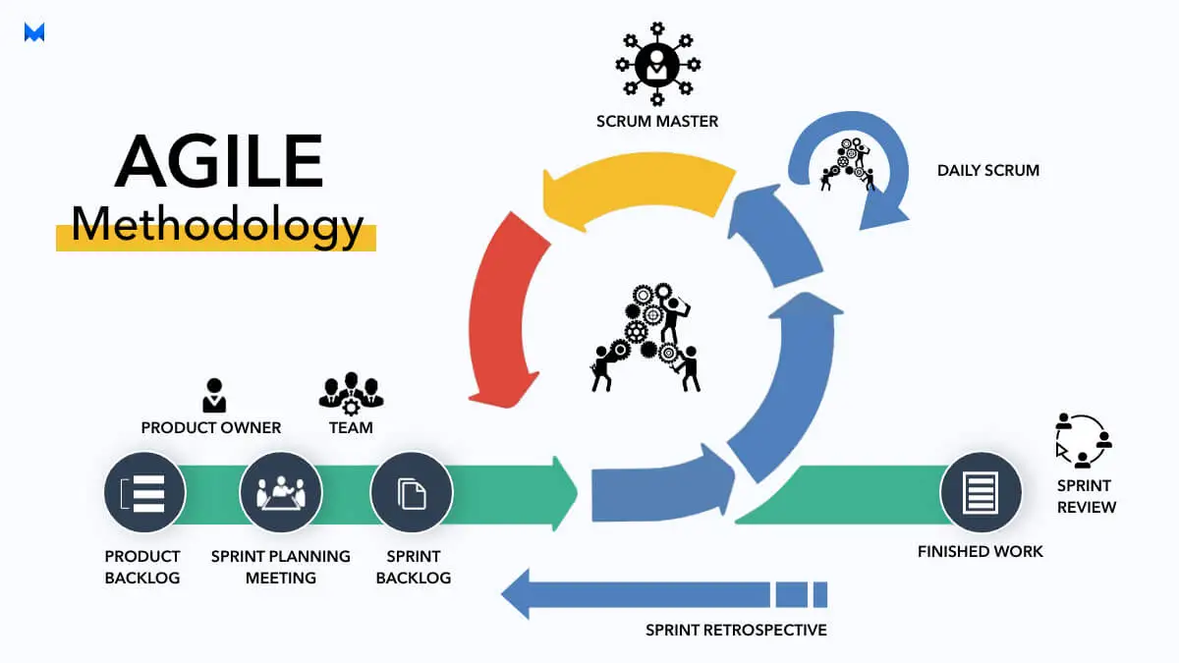
Challenge faced while implementing Learning 3
Though I have done waterfall and Agile in college, it was a nice recap in the bootcamp. The concepts sounded heavy at first but were conveyed in a very easy manner. It does take some time to get through it in detail but it is necessary.
And its great to hand on the azure devops

Slide 17

Action Plan

Slide 18
My Action Plan for this Week
Actions
Timeline
Status
Going through the concepts taught in Business analysis
Understand Agile process and scrum workflow
Practice the azure devops complete
Try doing scrum
Saturday- Go through the Soft skills concepts
Sunday- Brush-up the concepts taught in this week
Recap the touch with azure devops
Completed azure
Try retrospective

Slide 19

Learning is also Fun!

Slide 20
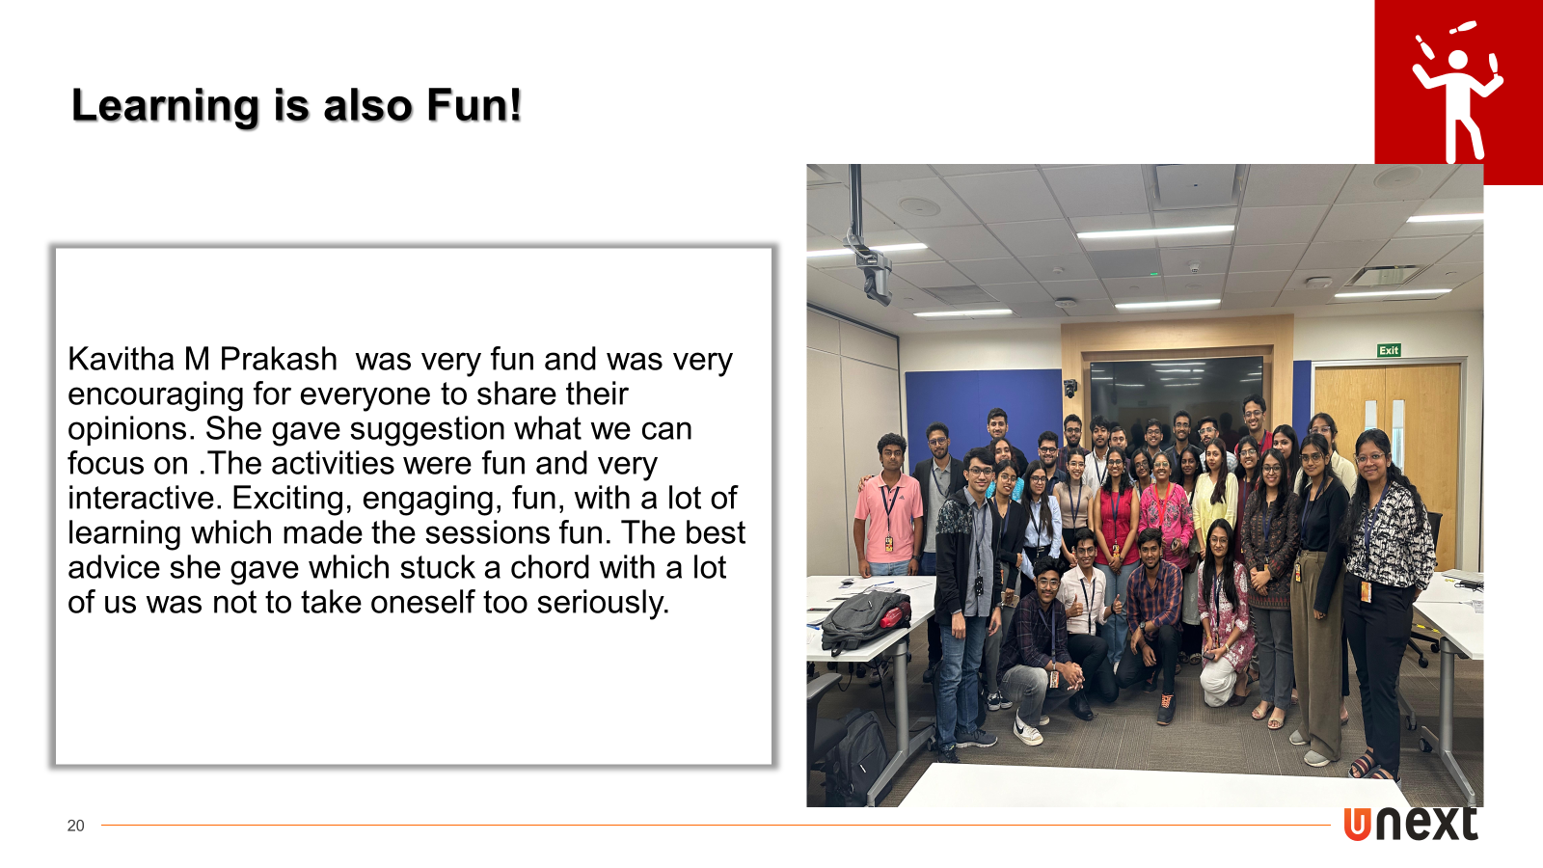

Slide 21

Summary
Learned soft skills, BA & agile
How to use azure dev ops and how assign
Will revise SDLC and steps learned from college
Software setup is needed and practice the azure and try scrum

Slide 22
Thank You

